Slide 1
Relationships

Slide 2
Relationships
When you model a system, not only must you identify the things that form the vocabulary of your system, you must also model how these things stand in relation to one another.
In object-oriented modeling, there are three kinds of relationships that are most important: dependencies, generalizations, and associations.

Slide 3
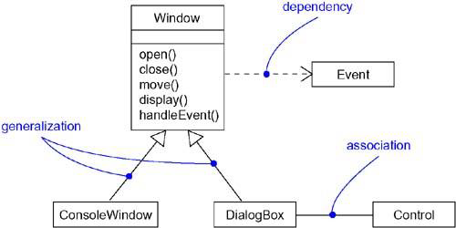
Relationships

Slide 4
1.Dependency
A dependency is a using relationship.
In this relationship one thing depends on the other thing.
The change in independent thing will affect the dependent thing.
Dependency is graphically represented as a dashed directed line.
The arrow head points towards the independent thing.

Slide 5
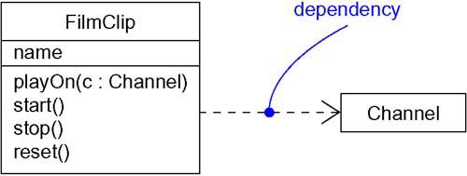
1.Dependency

Slide 6
2. Generalization
A generalization is a relationship between a general thing (called the super class or parent)and a more specific kind of that thing (called the subclass or child).
Generalization is sometimes called an "is-a-kind-of" relationship.
Graphically, generalization is rendered as a solid directed line with a large open arrowhead, pointing to the parent.

Slide 7
2. Generalization
Use generalizations when you want to show parent/child relationships.
A class may have zero, one, or more parents.
A class that has no parents and one or more children is called a root class or a base class.
A class that has no children is called a leaf class.
A class that has exactly one parent is said to use single inheritance; a class with more than one parent is said to use multiple inheritance.

Slide 8
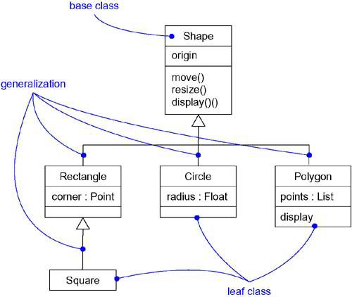
2. Generalization

Slide 9
3. Association
An association is a structural relationship that specifies that objects of one thing are connected to objects of another thing.
Given an association connecting two classes, you can navigate from an object of one class to an object of the other class, and vice versa.
It is also common for a thing to have a self association.

Slide 10
3. Association
An association which connects exactly two classes is known as binary association.
An association which connects n number of classes is known as n-nary association.
Graphically, an association is rendered as a solid line connecting the same or different classes.
Use associations when you want to show structural relationships.
Apart from this basic representation, an association has four adornments:

Slide 11
1. Name
An association can have a name, and you use that name to describe the nature of the relationship.
The name is written on top of the association.
We can also represent the direction in which the name is read.

Slide 12
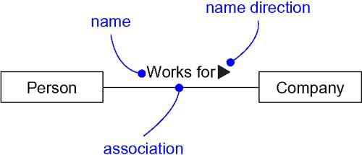
1. Name

Slide 13
2. Role
When a class participates in an association, it has a specific role that it plays in that relationship.
This role can be represented by writing it outside, near to the thing and below or above the association.

Slide 14
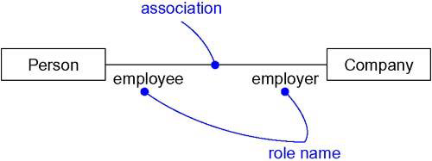
2. Role

Slide 15
3. Multiplicity
When connecting things with association, we are concerned about how many objects of one class can connect across an instance of the association.
This “how many” is known as multiplicity of an association’s role and is written as an expression.

Slide 16
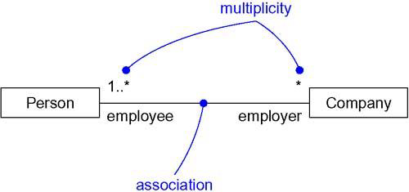
3. Multiplicity

Slide 17
4. Aggregation
Sometimes, you will want to model a "whole/part" relationship between two things, in which one class represents a larger thing (the "whole"), which consists of smaller things (the "parts").
This kind of relationship is called aggregation, which represents a "has-a" relationship, meaning that an object of the whole has objects of the part.
Aggregation is really just a special kind of association and is specified by adorning a plain association with an open diamond at the whole end.

Slide 18
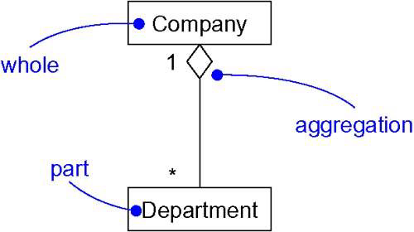
4. Aggregation

Slide 19
Common Modeling Techniques
There are three types of modeling techniques for relationships.
Modeling Simple Dependencies
Modeling Single Inheritance
Modeling Structural Relationships

Slide 20
1. Modeling Simple Dependencies
To model this using relationship,
Create a dependency pointing from the class with the operation to the class used as a parameter in the operation.

Slide 21
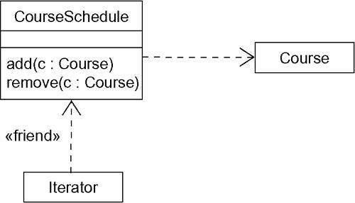
1. Modeling Simple Dependencies

Slide 22
2. Modeling Single Inheritance
To model inheritance relationships,
Given a set of classes, look for responsibilities, attributes, and operations that are common to two or more classes.
Elevate these common responsibilities, attributes, and operations to a more general class. If necessary, create a new class to which you can assign these elements (but be careful about introducing too many levels).
Specify that the more-specific classes inherit from the more-general class by placing a generalization relationship that is drawn from each specialized class to its more-general parent.

Slide 23
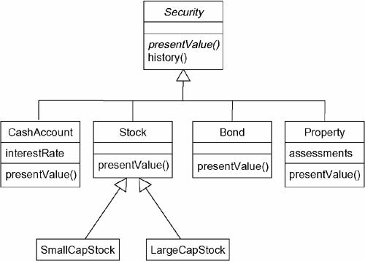
2. Modeling Single Inheritance

Slide 24
3. Modeling Structural Relationships
To model structural relationships,
For each pair of classes, if you need to navigate from objects of one to objects of another, specify an association between the two. This is a data-driven view of associations.
For each pair of classes, if objects of one class need to interact with objects of the other class other than as parameters to an operation, specify an association between the two. This is more of a behavior-driven view of associations.

Slide 25
3. Modeling Structural Relationships
For each of these associations, specify a multiplicity (especially when the multiplicity is not *, which is the default), as well as role names (especially if it helps to explain the model).
If one of the classes in an association is structurally or organizationally a whole compared with the classes at the other end that look like parts, mark this as an aggregation by adorning the association at the end near the whole.

Slide 26
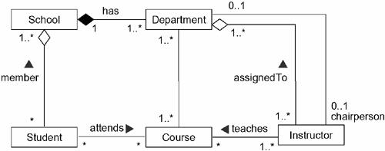
3. Modeling Structural Relationships

